Slide 1


Slide 2

This project utilizes the Netflix Titles Dataset which provides a comprehensive catalog of all movies and TV shows available on the Netflix platform. The dataset includes key features such as title, type of content, director, cast, country of production, date_added, release_year, rating, duration, and genre (listed_in). The primary goal is to perform Exploratory Data Analysis (EDA) to uncover trends, distribution patterns, and insights into Netflix's content library.
Exploratory Data Analysis Project
On
Library`s used during this project :-
  Pandas.
  Matplotlib
  Seaborn
  Plotly

Slide 3
Netflix Data :- Structure, Summary & Import
Data-Set Name :- netflix_titles.csv
Data Types & Null Summary :-
netflix.info ( )
Statistical Summary :-
netflix.describe ( )
Code for Data-Set Load :-
import pandas as pd
netflix = pd.read_csv("netflix_titles.csv")
netflix
Missing Data Check :-
Identifies columns containing null/missing
values to plan data cleaning steps.
Data Description :-
This dataset contains information about Netflix Movies and TV Shows including directors, country, ratings, release year, duration, and genres.
Objective :-
This slide presents the initial steps of the EDA process by importing the Netflix titles dataset and examining its structure. It includes data types, statistical summary, and missing value insights to understand data quality before visualization and analysis.
Dataset Overview :-
• Total Records: 8807
• Total Columns: 12
• File Format: CSV
• Key Columns: title, director, country, rating, release_year,duration, genres

Slide 4
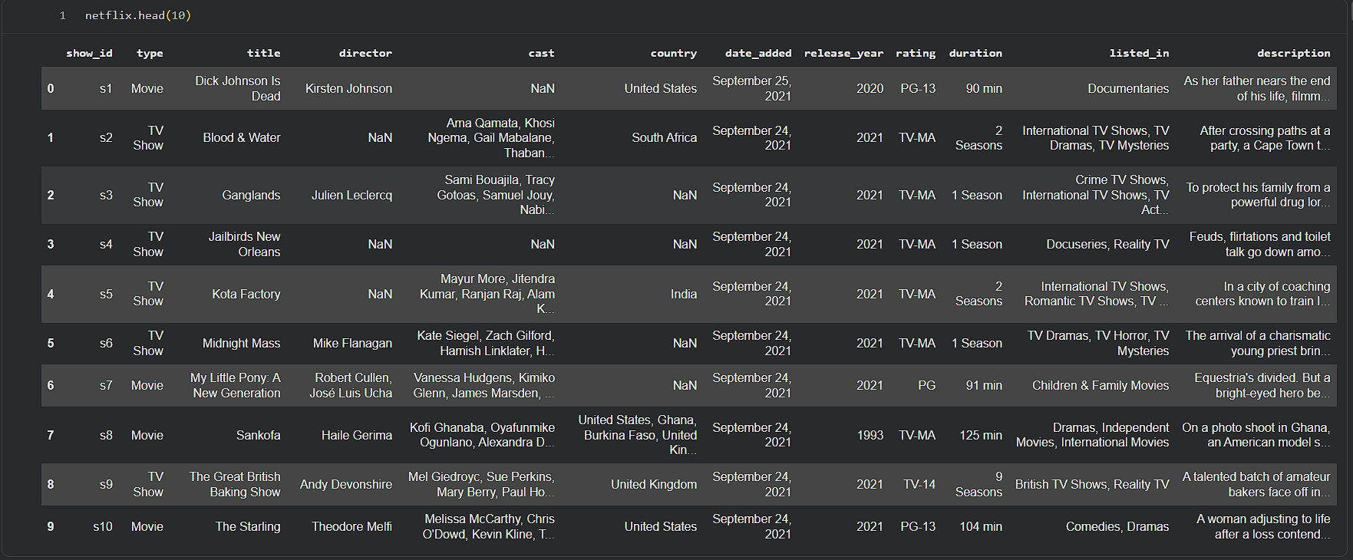
Netflix Data & Column Preview
First 10 rows displayed to understand dataset structure and column values.
netflix.head (10)

Slide 5
Data Cleaning & Pre-Processing
Preparing Netflix data for analysis by inspecting structure, removing inconsistencies, and extracting time-based features.
Displayed column names.
Identified missing values per column.
Calculated unique values and cardinality.
Checked duplicate records.
Created a safe copy for non-destructive cleaning.
Trimmed whitespace in text columns.
Converted date_added into datetime format.
Extracted day, month, and year features.
Validated ratings using a predefined allowed list.
# Dataset inspection
netflix.columns
netflix.isnull ( ).sum ( )
netflix.nunique()
netflix.duplicated().sum()
# Text and date cleaning
df['date_added'] = df['date_added'].str.strip()
df['date_added'] = pd.to_datetime(
df['date_added'], format='%B %d, %Y', errors='coerce’ )
# Feature extraction
df['day_added'] = df['date_added'].dt.day
df['month_added'] = df['date_added'].dt.month
df['year_added'] = df['date_added'].dt.year
# Rating validation and final cleaned dataset
valid_ratings = [
"TV-MA", "TV-14", "TV-PG", "R", "PG-13", "TV-Y", "TV-Y7",
"PG", "TV-G", "TV-G", "NR", "G", "TV-Y7-FV", "NC-17",
"UR", "Not Specified"
]
df_clean = df[df['rating'].isin(valid_ratings)]
For importing library :-
import pandas as pd
For making the copy of a dataset :-
df = netflix.copy ( )

Slide 6
Data Analysis & Dataset Extremes
Extracting key outliers and dominant attributes to identify notable trends before visualization.
Oldest Movie Title :-
df.loc[df[df['type'] == 'Movie']['release_year'].idxmin(), 'title’]
Oldest TV Show Title :-
df.loc[df[df['type'] == 'TV Show']['release_year'].idxmin(), 'title’]
Director with Most Content :-
df[df['Director'] != 'Not Specified']['Director'].value_counts().idxmax()
Longest Duration TV Show :-
df.loc[df[df['Type'] == 'TV Show']['Duration_value'].idxmax(), 'Title’]
Longest Duration Movie :-
df.loc[df[df['Type'] == 'Movie']['Duration_value'].idxmax(), 'Title’]
Most Common Genre Category :-
df['listed_in'].value_counts().head(3)
Content Released Per Year :-
df['release_year'].value_counts()
Highly Unique Columns (Top 3) :-
df.nunique().sort_values
(ascending=False).head(3)
Common Country Producing Content :-
df['country'].value_counts().idxmax()

Slide 7





Data Visualization Overview
Understanding Netflix dataset through powerful visual storytelling using Python libraries.
Tools & Libraries Used for Visualization :-
Pandas → Data filtering, grouping & transformation.
Matplotlib → Standard static plots.
Seaborn → Enhanced statistical visuals.
Plotly → Interactive charts for presentations.
PowerPoint → Visual report design & storytelling.

Slide 8
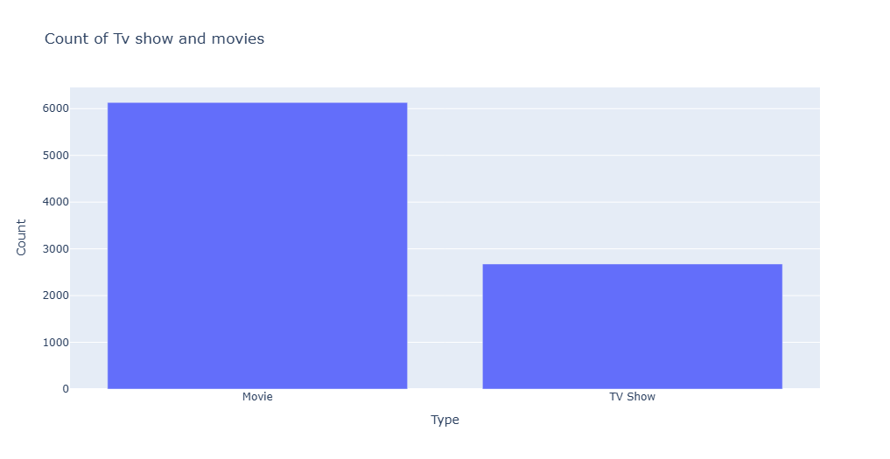
Count Analysis of Netflix Titles (Movies & TV Shows ) :-
import matplotlib.pyplot as plt
import plotly.express as px
px.bar(x=netflix['type'].value_counts().index,
y=netflix['type'].value_counts().values,
labels={"x": "Type", "y": "Count"},
title="Count of Tv show and movies")
px.show()

Slide 9
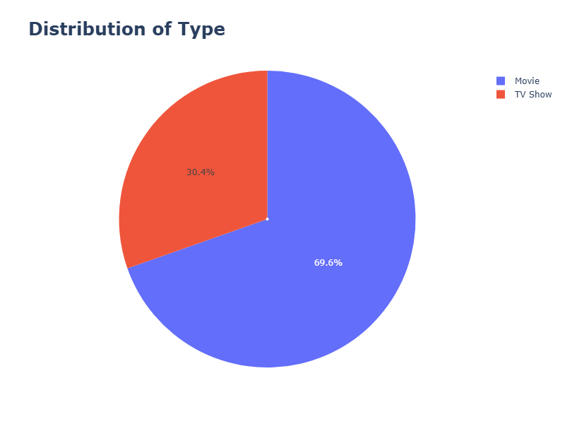
Distribution of Netflix Content by Type :-
import pandas as pd
import matplotlib.pyplot as plt
import plotly.express as px
fig = px.pie(
names=netflix['type'].value_counts().index,
values=netflix['type'].value_counts().values,
title="Distribution of Type",
hole=0.01)
fig.update_layout(width=800,
height=600,
title_font=dict(size=25,
weight="bold"))
fig.show()

Slide 10
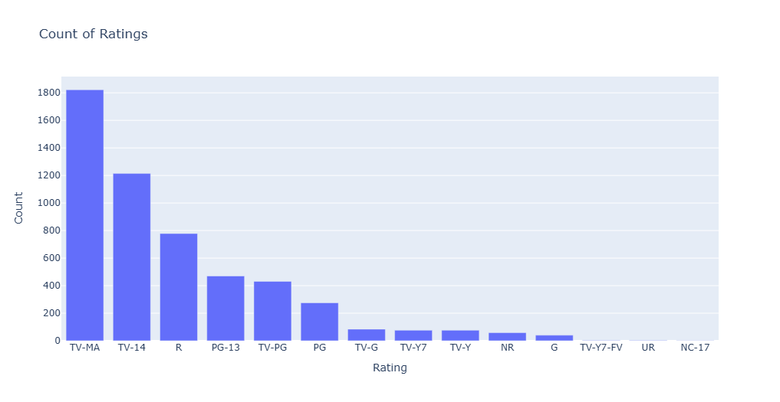
Netflix Content Ratings — Count Analysis :-
import pandas as pd
import matplotlib.pyplot as plt
import plotly.express as px
px.bar(x=df['rating'].value_counts().index,
y=df['rating'].value_counts().values,
labels={"x":"Rating","y":"Count"},
title="Count of Ratings").show()

Slide 11
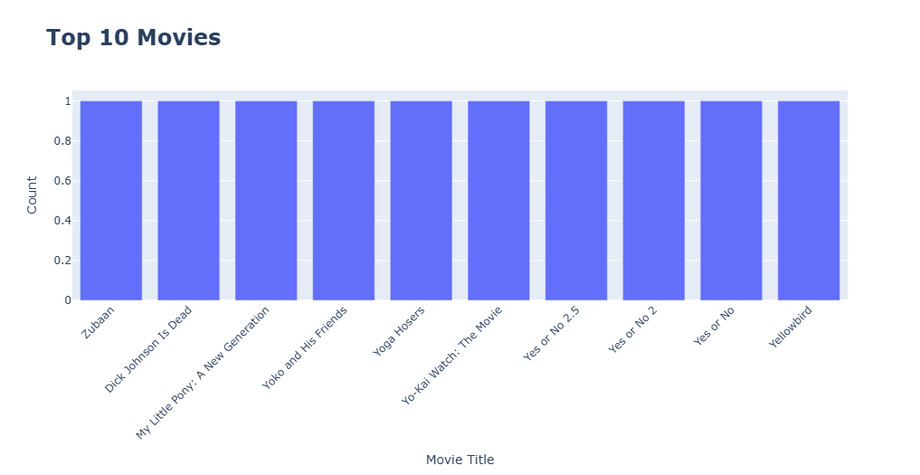
Top 10 Most Listed Movies — Frequency Analysis :-
import pandas as pd
import matplotlib.pyplot as plt
import plotly.express as px
top = netflix[netflix['type'] == 'Movie']['title'].value_counts()
.head(10)
fig = px.bar(
x=top.index,
y=top.values,
title="Top 10 Movies",
labels={"x": "Movie Title",
"y": "Count"})
fig.update_layout(title_font=dict
(size=24, weight="bold"))
fig.update_xaxes(tickangle=-45)
fig.show()

Slide 12
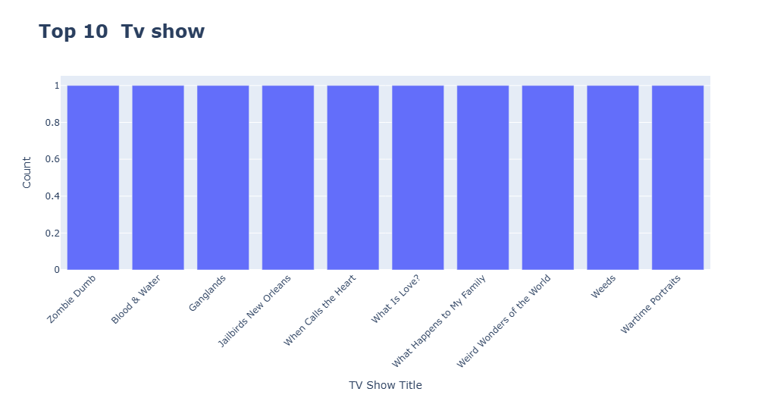
Top 10 Most Listed TV Shows — Frequency Analysis :-
import pandas as pd
import matplotlib.pyplot as plt
import plotly.express as px
top = netflix[netflix['type’]
== ‘TV Show’] ['title'].value_counts()
.head(10)
fig = px.bar(
x=top.index,
y=top.values,
title="Top 10 Tv show",
labels={"x": "TV Show Title", "y": "Count"})
fig.update_layout(title_font=dict
(size=24, weight="bold"))
fig.update_xaxes(tickangle=-45)
fig.show()

Slide 13
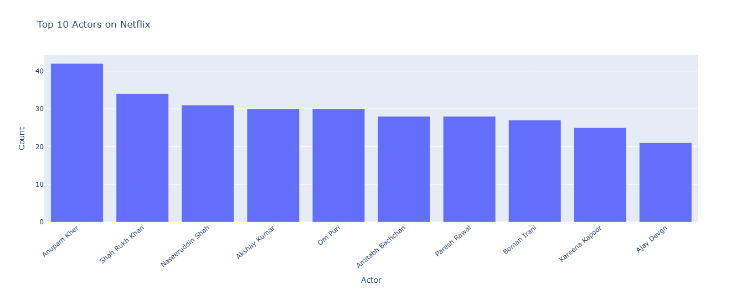
Top 10 Actors on Netflix — Frequency Analysis :-
import pandas as pd
import matplotlib.pyplot as plt
import plotly.express as px
actors = df[df['cast'] != 'Not Specified']['cast'].dropna()
.str.split(', ').explode()
top_actors = actors.value_counts().head(10)
.reset_index()
top_actors.columns = ['Actor','Count’]
fig = px.bar(top_actors, x='Actor', y='Count', title="Top 10 Actors on Netflix ")
fig.update_xaxes(tickangle=-40)
fig.show()

Slide 14
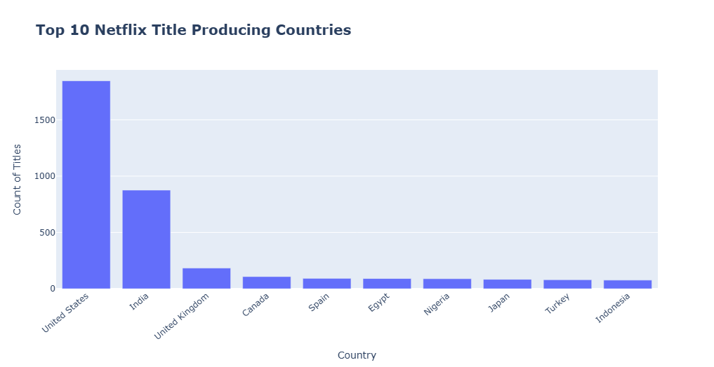
Top 10 Netflix Title-Producing Countries — Count Analysis :-
import pandas as pd
import plotly.express as px
import matplotlib.pyplot as plt
top = df[df['country'] != 'Not Specified']['country’]
.value_counts().head(10)
.reset_index()
top.columns = ['country', 'count’]
fig = px.bar(top, x='country', y='count', title="Top 10 Netflix Title Producing Countries",
labels={'country':'Country','count':'Count of Titles’})
fig.update_layout(title_font=dict(size=20, weight="bold"))
fig.update_xaxes(tickangle=-40)
fig.show()

Slide 15
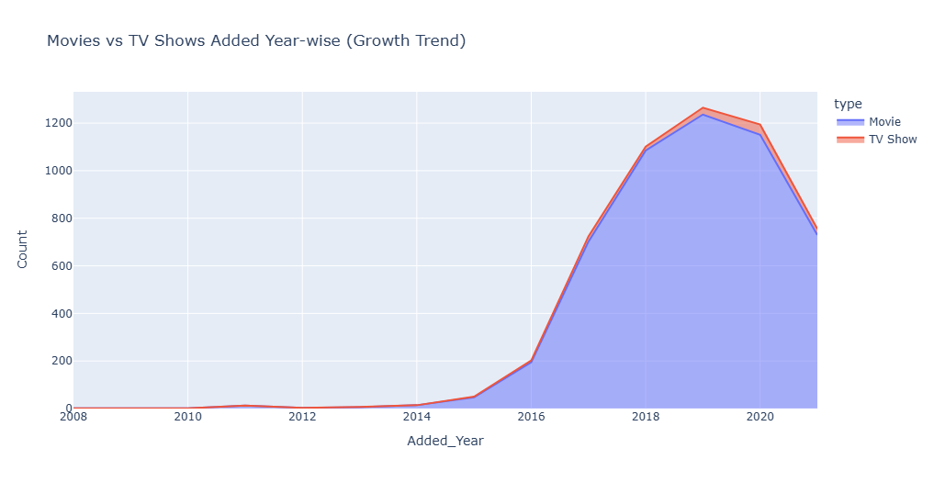
Year-wise Growth Trend of Netflix Content (Movies vs TV Shows) :-
import pandas as pd
import plotly.express as px
import matplotlib.pyplot as plt
df['date_added'] = df['date_added'].dropna()
df['Added_Year'] = pd.to_datetime(df['date_added’])
.dt.year
df_type_year = df[df['country’]
!= 'Not Specified’]
.groupby(['Added_Year','type’])
.size()
.reset_index(name='Count')
fig = px.area(df_type_year, x='Added_Year', y='Count', color='type',
title="Movies vs TV Shows Added Year-wise (Growth Trend)")
fig.show()

Slide 16
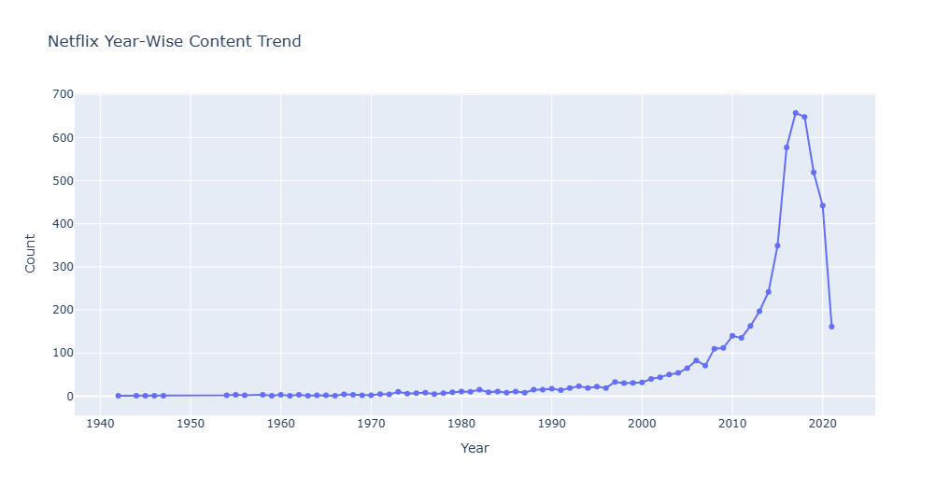
Year-Wise Trend of Netflix Content Releases :-
import pandas as pd
import matplotlib.pyplot as plt
import plotly.express as px
df_year = df['release_year'].value_counts().sort_index().reset_index()
df_year.columns=['Year','Count’]
fig = px.line(data_frame=df_year, x='Year', y='Count', title="Netflix Year-Wise Content Trend", markers=True)
fig.update_traces(marker_size=6)
fig.show()

Slide 17
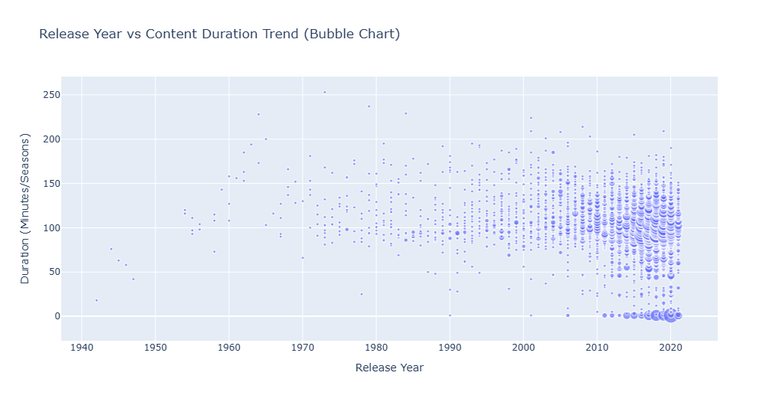
Release Year vs Content Duration — Bubble Trend Analysis :-
import pandas as pd
import plotly.express as px
import matplotlib.pyplot as plt
df_dur = df['duration'].dropna()
.str.extract('(\d+)').astype(float)
df['Duration_Num'] = df_dur
df_bubble = df.groupby(['release_year’,
'Duration_Num']).size()
.reset_index(name='Count')
fig = px.scatter(df_bubble, x='release_year', y='Duration_Num’, size='Count',
title="Release Year vs Content Duration Trend (Bubble Chart)",
labels={"release_year":"Release Year", "Duration_Num":"Duration (Minutes/Seasons)"})
fig.show()

Slide 18
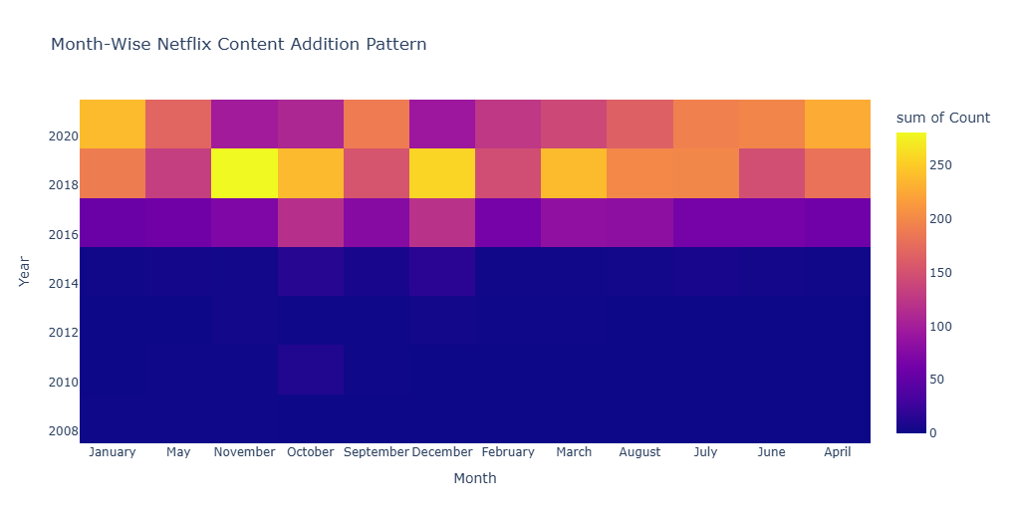
Month-Wise Pattern of Netflix Content Addition (Heatmap) :-
import pandas as pd
import plotly.express as px
import matplotlib.pyplot as plt
df['Added_Year'] = pd.to_datetime(df['date_added']).dt.year
df['Added_Month'] = pd.to_datetime(df['date_added']).dt.month_name()
df_heat = df.groupby(['Added_Year','Added_Month']).size().reset_index(name='Count')
fig =
px.density_heatmap(df_heat, x='Added_Month', y='Added_Year', z='Count',
title="Month-Wise Netflix Content Addition Pattern",
labels={"Added_Month":"Month", "Added_Year":"Year"})
fig.show()

